Slide 1

A God who vindicates
1st September 2019
Notes:
Update and encouragement to prayerfully reflect.
Hotspot today and Linda will return to this in a few weeks.

Slide 2
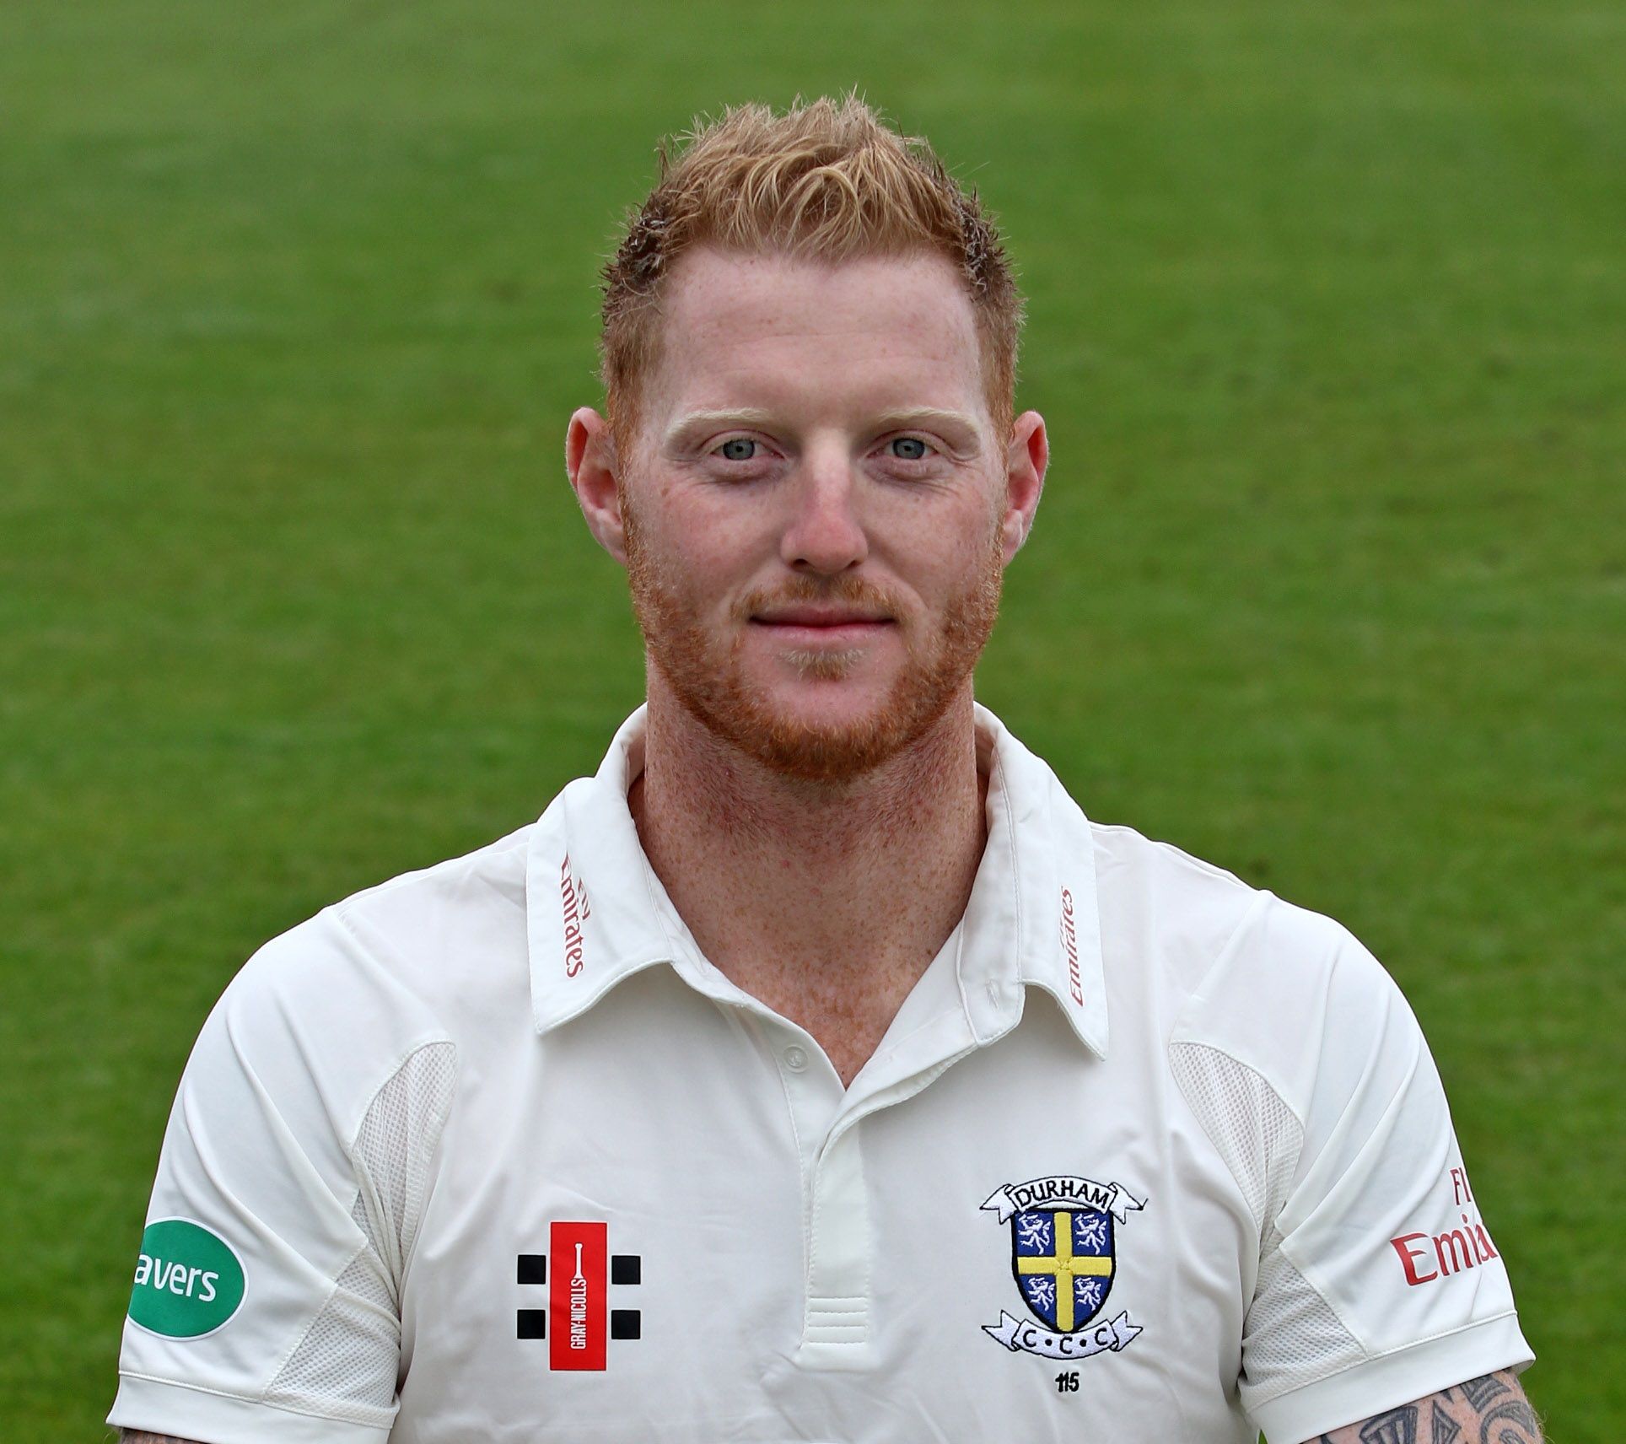

Slide 3
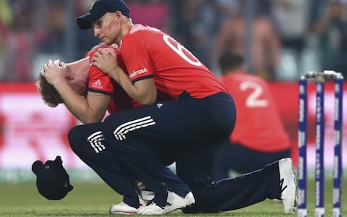
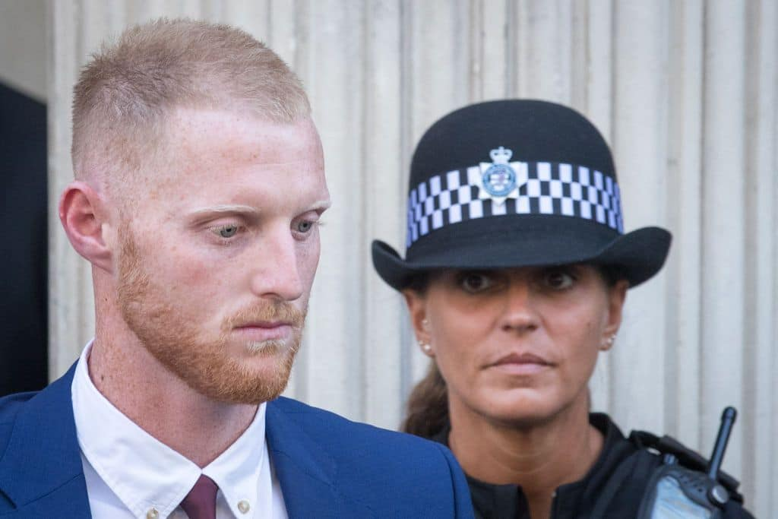
April 2016
September 2017

Slide 4
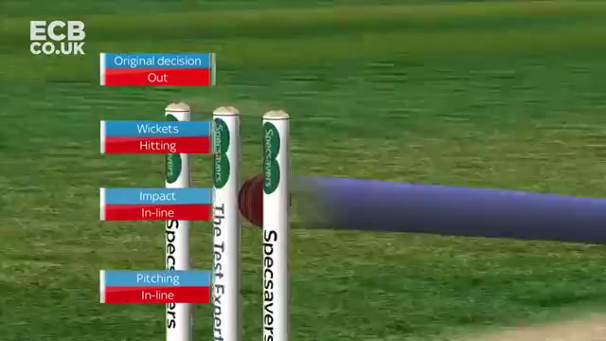
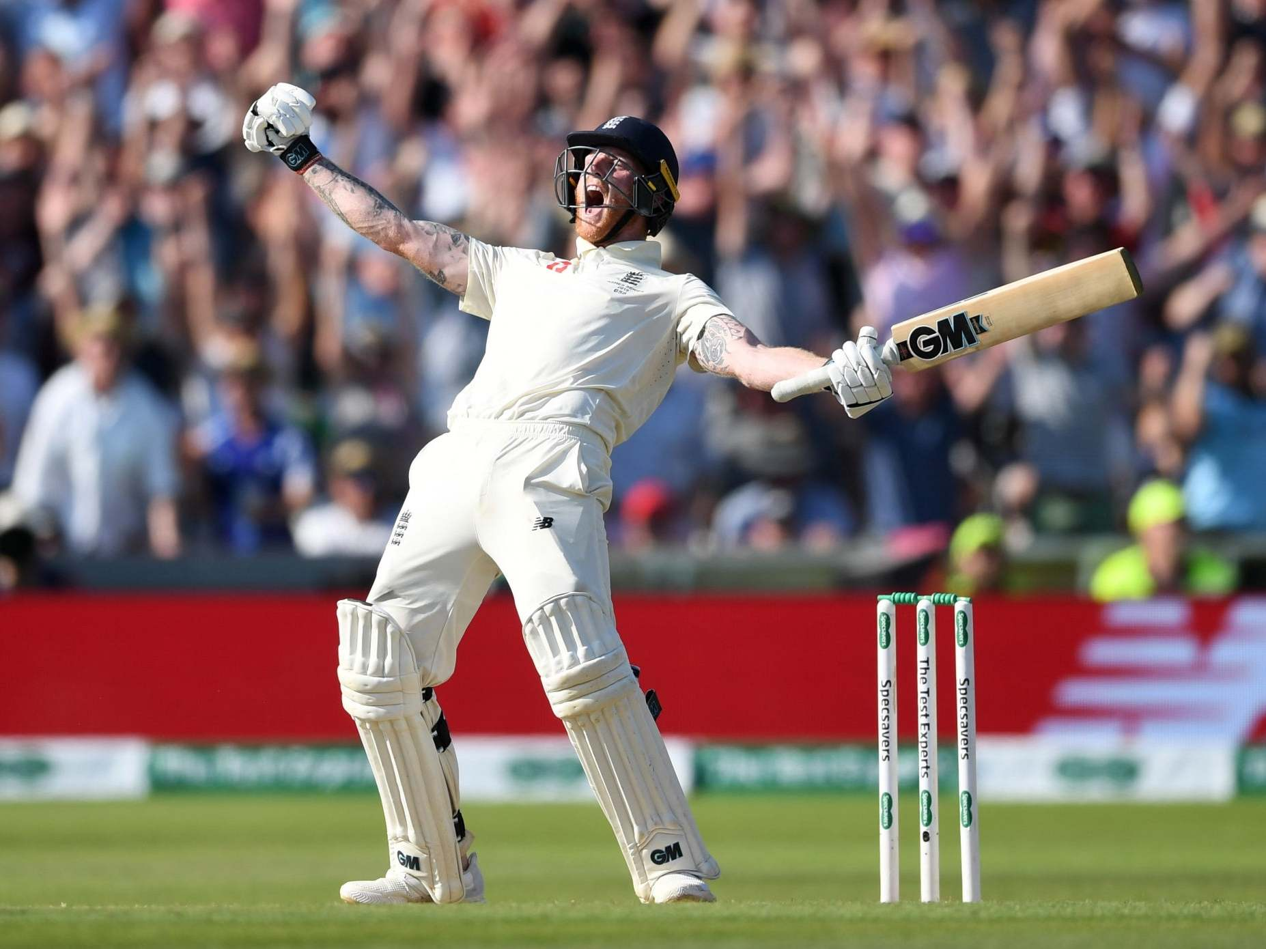

Slide 6
‘Ben Stokes vindicated by match winning performance’ ???

Slide 7
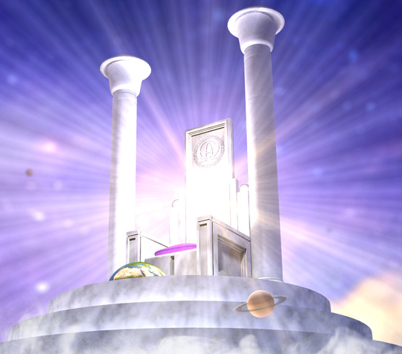
Gods
mighty
justice
BEYOND our comprehension. We can’t challenge or reason with it
A central and FUNDAMENTAL part of his nature and holiness
Retributive, RESTORATIVE, Rewarding elements to His justice
Righteousness and justice are the foundation of your throne;
steadfast love &faithfulness go before you.” —Psalm 89:14

Slide 8
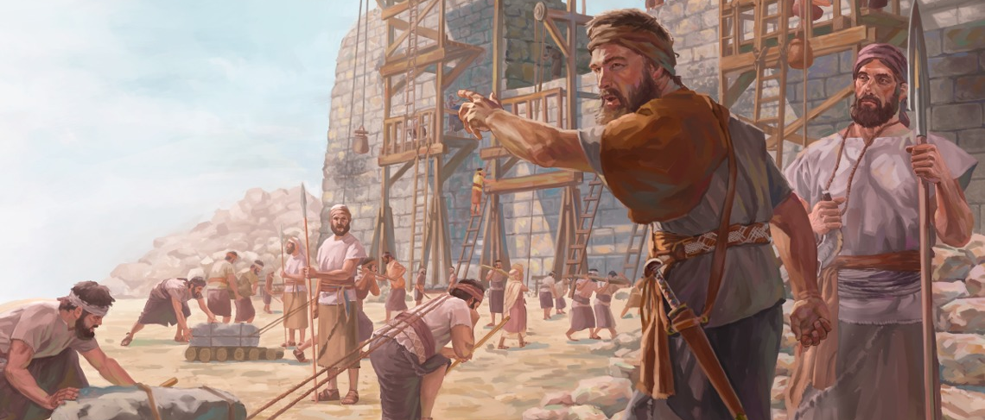
Nehemiah
445 BC. The King’s cupbearer Visited by brother Fasts, prays, acts
Building work
Sanballat and Tobiah persuasion, blackmail, threats and intimidation.
Governor
Dedicates the walls
Reintroduces traditions

Slide 9
Nehemiah 4:4
Hear us our God for we are despised. Turn their insults back on their own heads….Do not cover up their guilt from your sight
Nehemiah 6: 9-14
They were all trying to frighten us, …. but I prayed, “Now strengthen my hands…. “Should a man like me run away?....I will not go!” ....Remember Tobiah and Sanballat, my God, because of what they have done and how they have been trying to intimidate me.
Nehemiah 9
Blessed be your name and may it be exalted above all blessing and praise. You alone are the LORD.<> We are in great distress.

Slide 10
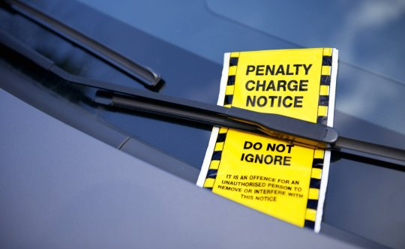
What does vindication mean ?
Justify we were at fault but have now been made right
Vindicate we were not at fault, rather we were in the right,
and where that is revealed /brought into the open.

Slide 11
A God who vindicates
Tough times
Opposition
Injustice
Righteousness and justice are the foundation of your throne; steadfast love and faithfulness go before you.” —Psalm 89:14
‘Hear us O God.’ ‘We are in great distress.’
‘Strengthen our hands.’ ‘Remember them.’

Slide 12
A God who vindicates
1st September 2019
Notes:
Update and encouragement to prayerfully reflect.
Hotspot today and Linda will return to this in a few weeks.

